Slide 1

Game Instructions
Click Start — a butterfly will appear on a certain number of flowers.
On the right side, click the item that matches the number of flowers the butterfly is on.
If you click the correct match, the butterfly will move forward.
Click quickly to get all the stars.

Slide 3
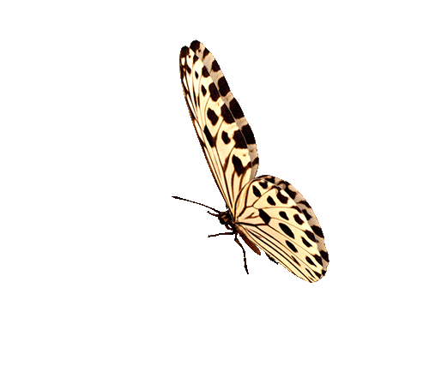


Start
1
2
3
4
5
Excellent
Great!
You can do Better
Great!
You can do Better
Great!
You can do Better
Great!
You can do Better
Great!
You can do Better
Great!
You can do Better
Retry
Exit

